Slide 1
Standard User – Initiate Contract from a Template
February, 2013

Slide 2

Learning Objectives
Upon completion of this course you will be able to:
Initiate a new contract using a Contract Template

Slide 3
Authoring a Contract
Authoring a contract is the process of initiating and negotiating a contract with a third party. Contracts can be authored using five different approaches:
Interview: An Interview is like an application “wizard”. You can answer a series of questions and the information is used to automatically create the contract.
Template: A contract can be authored from a template that contains previously defined language.
Filed Contract : Author a Contract from a Non-Revisable File, possibly received from a third party Contract. Filing a contract captures important contract summary data for contracts that were not authored in ECM. Contracts in non-revisable formats such as PDF, can be tracked and managed using the features and functions of ECM. A Filed contract often is used for Legacy contracts brought into the system.
Received Contract: Author a Contract from a Revisable File, possibly received from a third party. Contracts can be authored using MS Word documents. The Word documents may be received from third party partners.
Save As: Author from a Clone of a previously created contract that was saved using the Save As feature.

Slide 4
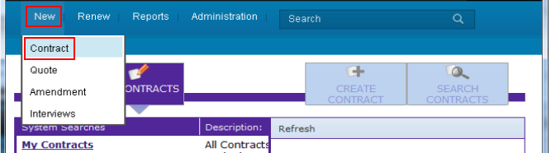

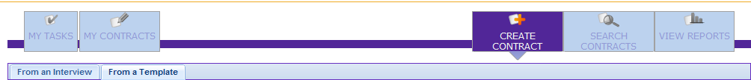
Initiate a New Contract
Select New > Contract from the top menu bar.
OR
From the Contract Home Page, select the Create Contract button
Select From an Template tab

Slide 5
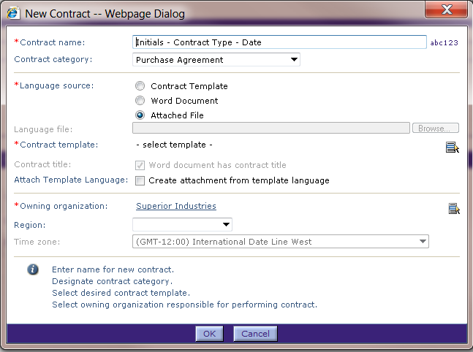
Initiate a New Contract, cont.
The New Contract window is displayed.
  Note that required fields are identified with a red * asterisk in front of the field name.
Enter the Contract Name.
Choose the Contract Category from the drop down menu:
  Purchase Agreement: May include contract line items based on products being purchased
  Sales Agreement
  Other

Slide 6
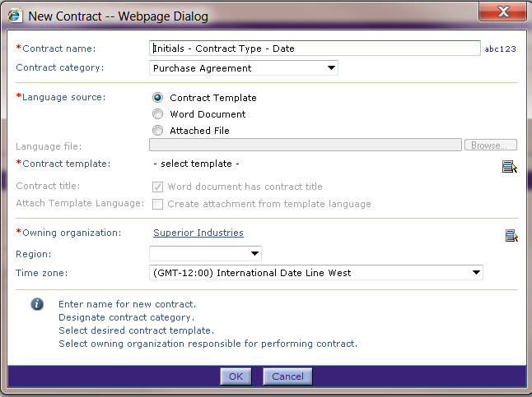
Initiate a New Contract, cont.
Click the Language Source > Contract Template radio button.
    This identifies that the language for the contract will be in a Template.
Click the Select icon to search for the appropriate Contract Template.

Slide 7
“Language Source” Values
The terminology can be a bit confusing. Choosing:
  “Contract Template” is for creating an Authored contract
  “Word Document” = a Received contract
  “Attached File” = a Filed contract
Authored and Received contracts have mostly the same operational characteristics; e.g., regarding presentation. Filed contracts are handled quite differently.

Slide 8
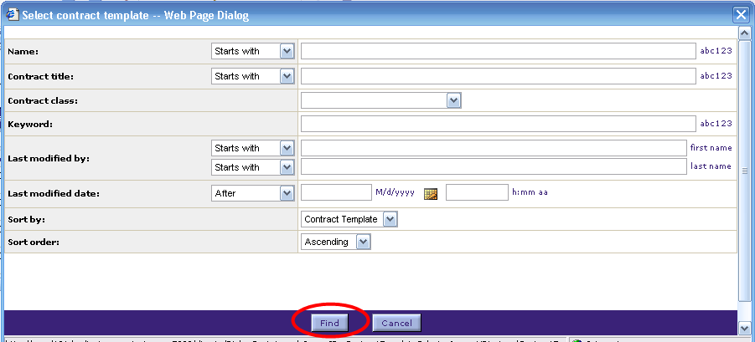
Select Contract Template
The Select Contract Template dialog box is displayed.
Contract Templates can be searched by defining specific attributes that match the desired template.
Or, leave all fields blank and click Find to display a list of all available templates based on the contract category

Slide 9
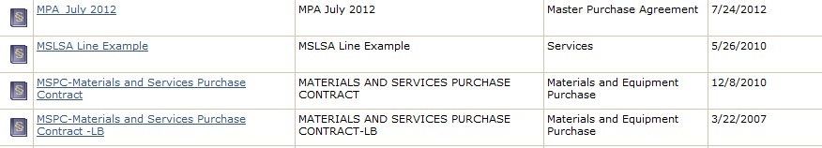
Select Contract Template
The list of templates matching your search criteria is displayed.
Click on the hyperlink of the name of the template to select it.

Slide 10
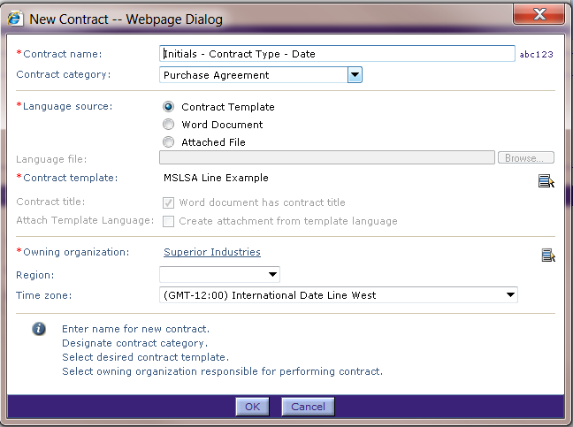
Select Contract Template
The Template Name for the selected template is displayed in the Contract template field.
The Owning Organization is the organization responsible for the contract.
Verify (or select) the Time Zone.
Click OK to create and save this contract in ECM.

Slide 11
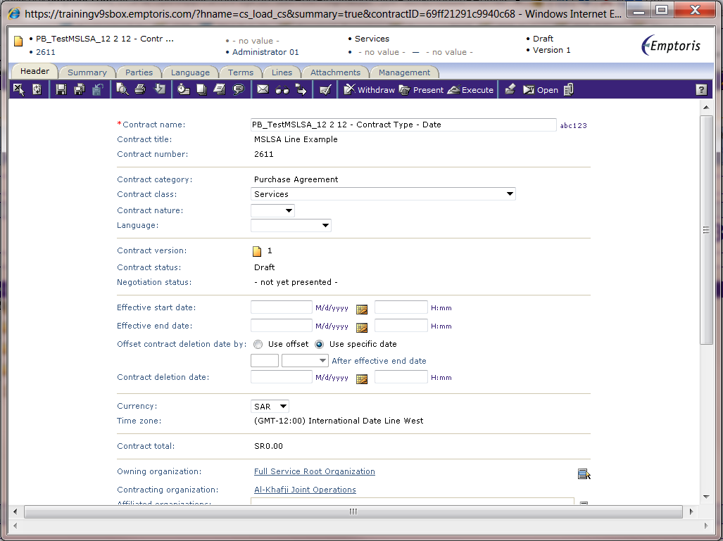
New Contract
The Contract opens in the Contract Editor window with Header tab displayed.
To exit the Contract Editor, click the X button located below the Header tab.
NB: Whenever Emptoris provides its own alternative to a browser button (e.g., X, or Refresh icon) use the Emptoris alternative

Slide 12
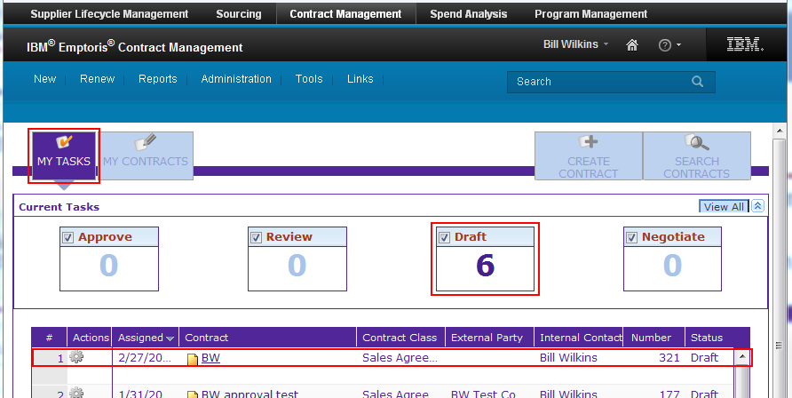
View New Contract
The Contract is added to the My Tasks list for Draft Contract tasks, and the Draft counter updated.
Click the Contract Name hyperlink to open the contract in the Contract Editor.

Slide 13

Questions?

